Slide 1
Netflix Data Analysis Project
Name: Vibhavi J
Department: MCA (VTU) Semester:Third
USN: 1BO23MC046

Slide 2
Outline
Title Name
Outline
Abstract
Problem Statement
Proposed Solution
Short Video
Implementation
Output Screenshots
References

Slide 3
Abstract:
We all watch movies for entertainment, some of us never rate it, while some viewers always rate every movie they watch. This type of viewer helps in rating movies for people who go through the movie reviews before watching any movie to make sure they are about to watch a good movie. So, if you are new to data science and want to learn how to analyze movie ratings using the Python programming language, this article is for you. In this article, I will walk you through the task of Movie Rating Analysis using Python.

Slide 4
Problem Statement
With the rise of digital devices and applications, people often find themselves spending significant amounts of time on screens, which can lead to health issues such as eye strain, disrupted sleep, and a sedentary lifestyle. However, many individuals are unaware of how much time they spend on various applications and devices. This lack of awareness makes it difficult to adopt healthier digital habits and maintain a proper work-life balance.

Slide 5
Proposed Solution
Analyzing the rating given by viewers of a movie helps many people decide whether or not to watch that movie. So, for the Movie Rating Analysis task, you first need to have a dataset that contains data about the ratings given by each viewer. For this task, I have collected a dataset from Kaggle that contains two files:
one file contains the data about the movie Id, title and the genre of the movie
and the other file contains the user id, movie id, ratings given by the user and the timestamp of the ratings

Slide 6
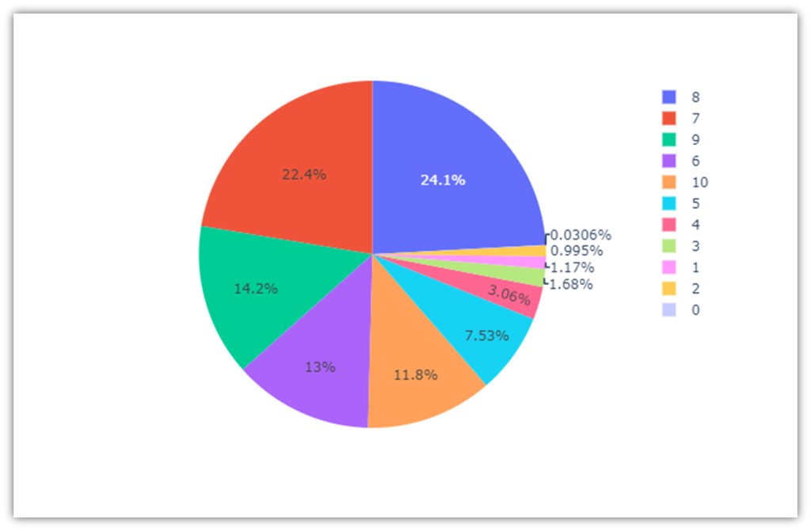
Output

